Slide 1


Digital Signal Processing ET0096
EEE DSP Teaching Team
Notes:
Digital signal processing has significantly changed the way electronic circuits and consumer products are developed today. It is widely used in cellular phones, MP3 players, DVD recorders and players, modems and digital cameras, all of which are now part of our daily lives. Digital signal processing has always been considered as a difficult subject because of the mathematical content. However, because of the tremendous growth in the last 30 years, it has become one of the core subjects in most electrical engineering courses.

Slide 2
Assessments
Mid-semester Test (90 min) 20%
Semester Exam (120 min) 40%
2 lab Tests (50min) 30%
General performance 10%
(Tutorial Presentation etc)
Notes:
The breakdown of assessment is given in this slide. There will be one MST whether online or written, one semester exam and 2 lab tests. For the General performance, students are required to show to their tutor on following week that the assignment is given.

Slide 3
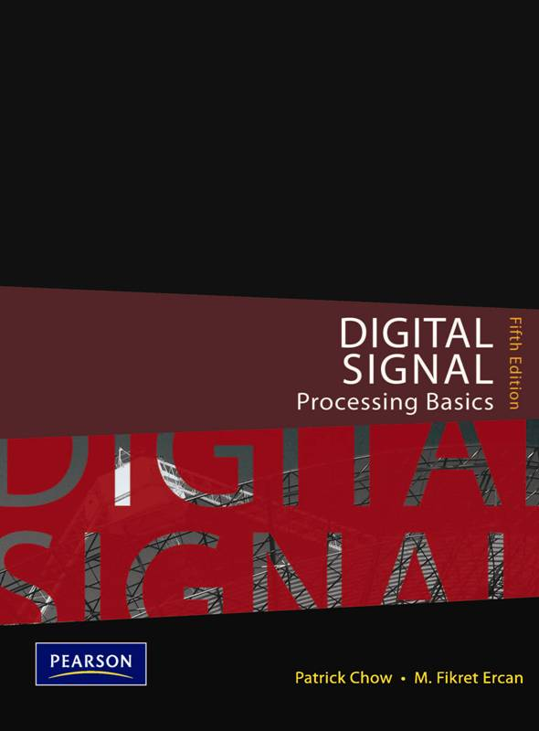
Reference books
Lecture (TEXT BOOK)
(NOT COMPULSORY! )
Other reference books:
Signal Processing First
James McClellan and Ronald Schafer
Digital Signal Processing
Oppenheim and Schafer
Author : Patrick Chow and M. Fikret Ercan
Publisher : Pearson
ISBN : 9789810684020
5th edition
See announcement where to buy
Notes:
It is highly recommended to get this textbook as it contains most of the topics taught. It costs around 30+. Do check it out with the bookshop earlier.

Slide 4
Resources
Tutorial
(Source: Questions in the book, module web site)
Lab
(Source: Book, Files in the LAB or module web side)
Blackboard
(For self-study, announcements, Past Exam Papers, sample solutions, guided tutorial solutions etc.)
Notes:
You can find most of the teaching resources if not all on the DSP blackboard. Do take some time to visit the blackboard to familiarize where the teaching materials are kept. If you have any difficulties, please check with your coursemates

Slide 5
Rules
100% Attendance
No Handphone
No Computer games
No Cross talk
Be Punctual
SIMPLY, DO NOT DISTURB CLASS!
Notes:
Some ground rules regarding attending the class either face to face or online. These measures are recommended so that we have effective learning. There should not be any eating in class as well and students do come prepare to answer questions for those tutorial questions that they do not understand. If more questions, the session can be a bit longer.

Slide 6
Tips to Score
Refresh your math (Complex numbers, Partial Fractions, Euler’s formula, Fourier Series etc., )
Refresh concepts (Frequency, phase, filter etc.)
Notes:
As Digital Signal Processing is a highly mathematical module, students are encouraged to review your engineering mathematics taught in your year 1 as we will not be going through the whole mathematic modules as time is not allocated.
Please revise your complex number, partial fraction, Euler formula and Fourier series.

Slide 7
9 Chapters, 8 Tutorials
Chapter 1 - the overall concept of digital signal processing.
Chapter 2 - Understand the concept of frequency domain analysis.
Chapter 3 - Conversion of Analog Signals to Digital Signals.
Chapter 4 - Interpret digital signals and systems mathematically.
Notes:
In Chapter 1, the overall concept of digital signal processing is introduced.
It covers the following : Describe what is a signal. Define what is an analog signal and what is a digital signal. Describe what is signal processing. Describe the overall scheme of a digital signal processor with the aid of a block diagram.
Compare the advantages and disadvantages of digital signal processing with traditional analog signal processing.
Chapter 2 help you to Understand the concept of frequency domain analysis. Explain how the spectral components of periodic signals can be obtained.
Infer how Fourier transform can be used to obtain the frequency spectrum of aperiodic signals. Describe how simple signals can be perceived in the frequency domain.
Chapter 3 talks Conversion of Analog Signals to Digital Signals.
Explain sampling theorem.
Deduce how undersampling leads to aliasing distortions.
Explain the sampling process in frequency domain.
Mention the tradeoffs involved in the selection of sampling frequency
Explain how an analog voltage may be represented by binary codes.
Chapter 4 is devoted to Interpret digital signals and systems mathematically.
Give examples of discrete-time signals and how they can be represented.
Explain how difference equations are used to model digital systems.
Explain how digital networks are used to describe difference equations.
Summarize the concepts of linearity and time-invariance.

Slide 8
9 Chapters
Chapter 5 - Understand the analytical tools used in time-domain analysis of digital systems.
Chapter 6 - Use of z-transform in signals and systems analysis.
Chapter 7 - Useful concept of discrete Fourier transform.
Chapter 8 - Introduces Information Theory and Coding.
Chapter 9 - Multimedia Signal Processing (Data compression).
Notes:
Chapter 5 helps you to Understand the analytical tools used in time-domain analysis of digital systems.
Deduce how impulse response can be obtained in a digital system.
Define discrete linear convolution and explain its properties.
Chapter 6 demonstrate the use of z-transform in signals and systems analysis.
Define the z-transform and explain its properties.
Explain how z-transform and inverse z-transform of common signals can be obtained using the standard z-transform table.
Explain how the system function of a digital system is obtained.
Explain how the frequency response of a digital system is obtained.
Describe the stability of a digital system.
Chapter 7 explores the useful concept of discrete Fourier transform. It focuses on how signals can be represented digitally in both time and frequency domains.
Define the DFT of a finite sequence.
Compare and contrast DFT and Fourier transform.
Chapter 8 introduces a very useful topic: Information Theory and Coding.
Understand the theory and coding that provides quantitative measures of information, analyse and characterize the fundamental limits of communication systems.
Understand basic concepts of information theory.
Understand the need for source coding for efficient and reliable digital communication.
Chapter 9 is the last chapter on Multimedia Signal Processing. Understand the fundamental principles and techniques in multimedia signal processing and compression and give an overview of the current multimedia standards and technologies, and future technologies.
Explain what is compression and the different components of multimedia signal.
Understand why compression is needed.
Define lossless and lossy compressions/methods.
Understand the different classification of lossless classifications.
Understand the constraints of multimedia on internet, wireless communication, and storage media like, DVD and others.
Know the different image and video formats.
Know the different standards for the image and video compression.
Understand what text, image, video and audio compression are.

Slide 9
Introduction
At the end of this chapter, students should:
Understand what is signal
Define what is an analog signal and what is a digital signal.
Describe what is signal processing.
Describe the overall scheme of a digital signal processor with the aid of a block diagram.
Compare the advantages and disadvantages of digital signal processing with traditional analog signal processing
Notes:
In this Chapter 1, the overall concept of digital signal processing is introduced.
It covers the following :
Describe what is a signal.
Define what is an analog signal and what is a digital signal.
Describe what is signal processing.
Describe the overall scheme of a digital signal processor with the aid of a block diagram.
Compare the advantages and disadvantages of digital signal processing with traditional analog signal processing

Slide 10
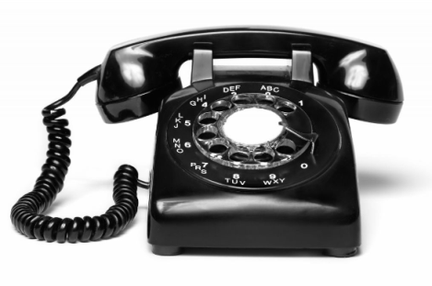

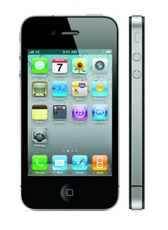
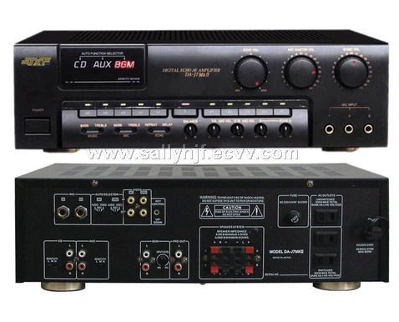
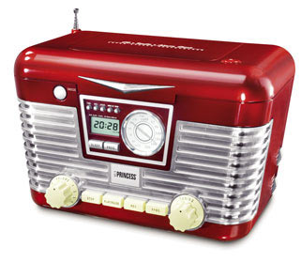
What is a signal?
A signal may be defined as any physical quantity that varies with time, space or other domains and it contains information which we are interested in.
Notes:
A signal may be described as any physical quantity that varies with time, space or other domains and it contains information which we are interested in. Imagine that you are standing at a traffic junction getting ready to cross the road. If the light showing the red man is lit up, you would stop and wait. If the light showing the green man comes on, you would cross the road. The lights showing the red man and the green man are physical entities that give you information. They are signals.
The above are common gadgets that we used every day. Signals are sent form different devices to the handphone.
What is the advantage and disadvantage of using digital signal over analog signal?
DSP has a high level of accuracy. The filters designed in DSP have firm control over output accuracy as compared to analog filters. The reconfiguration in an analog system is very much tough because the entire hardware and its component will have to be changed
A digital signal is a signal that is being used to represent data as a sequence of discrete values; at any given time it can only take on, at most, one of a finite number of values.
An analog signal is any continuous signal for which the time-varying feature of the signal is a representation of some other time-varying quantity, i.e., analogous to another time-varying signal.

Slide 11
Signal characteristics
Signals can further be classified as continuous-amplitude signals and discrete-amplitude signals with continuous time.
A normal sine or cosine wave is a continuous amplitude and continuous time signal.
A DC voltage is a discrete amplitude and continuous time signal.
Notes:
Signals can further be classified as continuous-amplitude(analog) signals and discrete-amplitude (digital) signals.
A normal sine or cosine wave is a continuous amplitude and continuous time signal.
A DC voltage is a discrete amplitude and continuous time signal.

Slide 12
Continuous and discrete amplitude signals
Continuous Signals also classified as:
continuous-amplitude signals
discrete-amplitude signals.
A continuous-amplitude can be any value of amplitude.
A discrete-amplitude can only be a finite set of discrete amplitude values.
Based on amplitude
Notes:
Continuous Signals also classified as: continuous-amplitude signals and discrete-amplitude signals.
A continuous-amplitude can be any value of amplitude.
A discrete-amplitude can only be a finite set of discrete amplitude values.
A normal sine or cosine wave is a continuous amplitude and continuous time signal.
A DC voltage is a discrete amplitude and continuous time signal.

Slide 13

Continuous and discrete amplitude signals
Example:
A continuous-amplitude can be any amplitude value.
A discrete-amplitude can only be a finite set of discrete amplitude values.
7 x 1$ coins
6.7315678 S$
Notes:
A continuous-amplitude can be any amplitude value.
A discrete-amplitude can only be a finite set of discrete amplitude values.

Slide 14
Signals
In this course, we will confine signals to those in electrical form.
Mathematically, we describe a signal, s, as a function of time, t.
Example: s(t) = 2.5 sin(200pt)=Asin(2πft)
This expression tells us how the signal, s(t) behaves when time changes.
Period, T = 1/f
Notes:
The expression, s denotes the signal as a function of time, t. A and f are the amplitude and frequency of the sine wave respectively. For different values of t, the corresponding values of s may be computed by substituting the values of t into the right hand side of the equation.
Here we have a sine wave of amplitude 2.5 and a frequency of 100 Hertz. You can refer to page 2 of the textbook for more information. A is 2.5 and f is 100
Period, T is 1 over f which is 10 milliseconds

Slide 15
Quiz
Given a signal, y(t) = 10 sin(2000 π t), what is the maximum positive amplitude, A?
A. 10
B. 5,
C. 2
D. 1

Slide 16


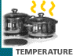
Examples of signals
Sounds that we hear.
Images that we see.
Warmth or chill that we feel.
Notes:
An analog signal is any continuous signal for which the time-varying feature of the signal is a representation of some other time-varying quantity, i.e., analogous to another time-varying signal such as sound, light intensity and temperature.
Transducers will onvert the physical signals into electrical form. One good example of a transducer is the microphone which converts the sound pressure to an electrical voltage. A loud sound would produce a large electrical voltage while a high pitch sound would produce a voltage that changes its amplitude very rapidly. Information in signals is encrypted into the way the electrical voltage changes and how fast it changes. These are analog signals, unless digitized which will be covered in the later chapters.

Slide 17
Other examples of signals
An electrical voltage as a function of time.
A light intensity as a function of x, y and z coordinates and time.
A potential as a function of position in a 3-dimensional space.
A force as a function of time and position.
Notes:
An electrical voltage as a function of time.
A light intensity as a function of x, y and z coordinates and time.
A potential as a function of position in a 3-dimensional space.
A force as a function of time and position.
All these are analog signals

Slide 18
Continuous-time signals
(Based on time axis)
Signals can also be classified as:
Continuous-time signals
Discrete-time signals.
A continuous-time signal has values or information at every instance in time.
Notes:
Signals can also be classified as Continuous-time signals and Discrete-time signals. Note that we are referring to the x axix, time .
A continuous-time signal has values or information at every instance in time. It means that the signal has continuous line and there is not disjointed break in the curve.
Some examples of such signals are the body temperature of a patient, the speed of a car or the electrical voltage between two points in a circuit. In these examples, the signals exist all the time – there is no instance where the signals do not exist.

Slide 19
Discrete-time signals
A discrete-time signal has values or information only at certain discrete time instance, t1, t2…tn .
a1
a2
t3
tn
t1
t2
a3
an
Notes:
The y axis is the voltage value and the x-axis is time. A discrete-time signal has values or information only at certain discrete time instance, t1, t2…tn . The amplitude may not have discrete values.
A signal which has values, or is being observed, only at certain discrete time instances, is known as a discrete-time signal.
The main reason for the existence of discrete amplitude signals is that digital computers can only process finite-length binary codes. When we try to represent the signal amplitudes using a finite number of bits as used in a digital computer.

Slide 20
Analog and digital signals
In general signals are:
Analog signal
continuous-time
continuous-amplitude
Digital signal
discrete-time
discrete-amplitude
Notes:
A digital signal is a signal that is being used to represent data as a sequence of discrete values; at any given time it can only take on, at most, one of a finite number of values. It has the characteristics of discrete time and discrete amplitude.
An analog signal is any continuous signal for which the time-varying feature of the signal is a representation of some other time-varying quantity, i.e., analogous to another time-varying signal. It has the characteristics of continuous time and continuous amplitude.

Slide 21
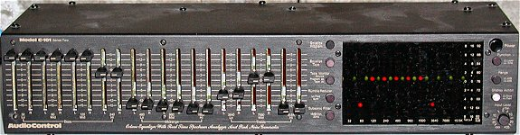
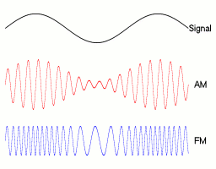
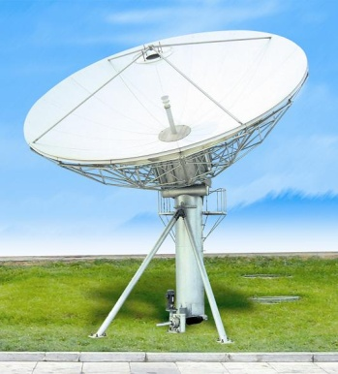
What is signal processing?
Signal processing refers to the manipulation or modification of a signal for a certain purpose.
Low pass filter →
Modulator →
Notes:
Signal processing may be defined as the manipulation or modification of a signal for a certain purpose.
For the first case, a speech signal which is contaminated with some high frequency noise. The effect of the noise may be reduced by passing this noisy signal through a low pass filter. The low pass filtering may be considered as a form of signal processing. You will see the high frequency noise is being removed.
Frequency modulation where a base band signal is used to modify the frequency of a carrier sinusoid so as to enhance transmission. In this case, a frequency modulation is being used.
The satellite diagram also shows show three types of modulations, amplitude modulation and AM, frequency modulation, FM

Slide 22
→Fourier transform →
→ Rectifier →
Digital Signal Processing, DSP : Using digital processors to perform on the digital
signals for a wide variety intended tasks.
Notes:
Signal processing is also used routinely in extracting information from a signal as in Fourier transform where the time domain pulse train signal is transformed or converted to another domain, the frequency. This will be further elaborated in Chapter 2.
Digital Signal Processing, DSP – using digital processors to perform on the digital
signals for a wide variety intended tasks.
Rectification or detection below where a signal is forced to have only positive values, used in demodulation and envelope detection. You will notice it to full wave bridge or centre tapped full wave rectification in power supply circuits. You can also perform full wave rectification through software.

Slide 23
Quiz 2
→ A →
Without referring to previous slides, what is the function of A?
Rectification
Modulation
Filtering
Fourier Transform

Slide 24
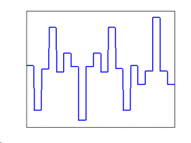
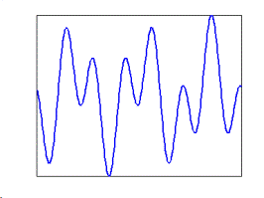
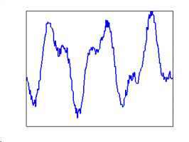
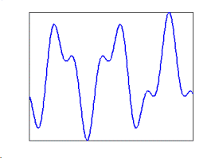
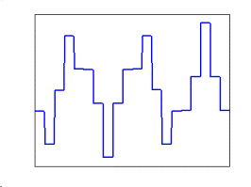
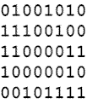
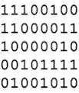
Block diagram of a digital signal processing system
Analog In
Analog Out
Anti-
aliasing
filter
Sampler
Quantizer
DSP
Dequantizer
Reconstruction
filter
CONT-TIME
CONT-AMP
CONT-TIME
CONT-AMP
DISC-TIME
CONT-AMP
DISC-TIME
DISC-AMP
DISC-TIME
DISC-AMP
CONT-TIME
DISC-AMP
CONT-TIME
CONT-AMP
Notes:
Many real-world signals are analog in nature such as an audio signal. On the other hand, a digital computer can only process binary numbers. Therefore, these analog signals have to be transformed into digital form before they can be processed by a processor. The diagram shows hardware building blocks of a typical DSP system.
The analog signal is in continuous time and continuous amplitude format. After going through the anti-aliasing filter, the output of the anti-aliasing filter is in still in continuous time and continuous amplitude format where the high frequency content is removed by the filter which perform some low-pass filtering function.
There are 6 basic building blocks that transformed the analog signals in continuous time, comtinuous amplitude format through various stages of signal processing.
Anti-aliasing filter, sampler, quantizer, Digital Signal Processing computation, Dequantizer and reconstruction filter.

Slide 25
Quiz
A
Sampler
B
What is signal characteristics of A?
Discrete time, continuous amplitude
Discrete amplitude, continuous time
Continuous time, continuous amplitude
Discrete amplitude, discrete time
Notes:
c

Slide 26
Quiz
A
Sampler
B
What is signal characteristics of B?
Discrete time, discrete amplitude
Discrete amplitude, continuous time
Continuous time, continuous amplitude
Continuous amplitude, discrete time
Notes:
d

Slide 27
Digital signal processing system
Anti-aliasing filter: Band-limits the analog signal​
Sampler: Converts continuous-time signal to discrete-time​
Quantizer: Converts continuous-amplitudes to binary code words.​
DSP: A special mP to process digital signal​
Dequantizer: Converts binary code words back to electrical signal.​
Reconstruction filter: Smoothens output signal and makes it continuous-amplitude.
Notes:
Anti-aliasing filter, This is usually a low pass filter used to bandlimit the analog input signal.
Sampler, To take discrete-time samples of the analog signals. In other words, it converts the continuous-time signal to a discrete-time signal.
Quantizer, To convert each sample of the signals into a binary codeword. In other words, it converts the continuous-amplitude signal to a discrete-amplitude signal and encodes the samples into binary codewords.
DSP, A special microprocessor designed to do fast calculations. It could also be a PC if it is being used for DSP application.
Dequantizer, To convert the binary codewords back to an electrical signal.
Reconstruction filter, This is usually a low pass filter used to smoothen the output signal such that it becomes continuous-amplitude.

Slide 28
Advantages and Disadvantages of DSP with traditional analog signal processing
Advantages: Accuracy, Easy to do modification especially through software means, easy to integrate into other part of the systems, lesser distortion.
Disadvantages: Cost, knowledge of firmware and time to learn how to do programming.
Notes:
DSP has a high level of accuracy. The filters designed in DSP have firm control over output accuracy as compared to analog filters. The reconfiguration in an analog system is very much tough because the entire hardware and its component will have to be changed. It also has lesser distortion of signals.
The disadvantages are higher cost to convert analog to digital signals and the digital processors plus the knowledge of the firmware and time to program the processor to achieve the function of the computations required.

Slide 29
We have learnt
what is a signal.
what is the difference between an analog signal and a digital signal.
what is signal processing and digital signal processing
Know the block diagram of a typical DSP system.
Compare and contrast the digital signal processing method versus traditional analog processing.
Notes:
In chapter 1 you have learnt what is a signal.
what is the difference between an analog signal and a digital signal.
what is signal processing and digital signal processing
Know the block diagram of a typical DSP system.
Compare and contrast the digital signal processing method versus traditional analog processing.
See you in the next lesson, chapter 2 where we will briefly covering Fourier Transform without going into the details.
Have a great day ahead

